Slide 1
Email Basics
Front-End Web Development

Slide 2
Pre-Class Materials and Preparation
Review all slides, lab activities, and code-alongs.
There are prompts in the speaker notes with opportunities for instructor customization.
Materials:
Reference Code
Starter Code in CodePen
Solution Code in CodePen

Slide 3
API Calls and Response Handling
Overview
This lesson introduces HTML forms and how JS can be used to collect and validate information from users.
Learning Objectives
In this lesson, students will:
Make HTTP requests to external API sources for data.
Evaluate APIs based on documentation.
Use API responses to update HTML content.
Duration: 180 minutes

Slide 4
Suggested Agenda
Time | Activity | Purpose
0:00–0:30 | What Are APIs/ Weather API Demo | Introduce APIs and demonstrate with a simple weather-fetching app.
1:00–1:30 | Evaluating and Using APIs | Give students some idea of how to tell good APIs from bad ones.
1:30–3:00 | Giphy Bank | Uses the Giphy API to create a fun GIF-searching app; could also incorporate flexbox/Grid to layout the results.

Slide 5
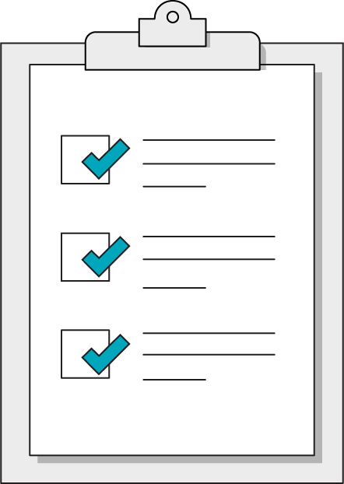
Today’s Learning Objectives
In this lesson, you will:
Learn the basics of email layout
Understand the rendering environment that emails use
Understand how to send out emails
‹#› | © 2020 General Assembly
Notes:
DURATION: 1 minute
TEACHING TIPS:
Learning objectives help frame the lesson and give students an idea of what to expect and focus on.
Explain to students how this lesson fits into the overall course to help them make connections with content from other lessons.

Slide 6
Warm Up - The Bad Intern
Front-End Web Development
Notes:
TALKING POINTS:
Many websites show their users information from third-party sources. Thanks to APIs, you can use JavaScript to request and use information from all across the web — whether it’s a weather report, a stock price, or the latest news headlines.
It’s time for our websites to become full-fledged citizens of the internet by interacting with other applications through AJAX requests!

Slide 7
The Bad Intern
30 minutes
Our horrible intern has gone full agricultural on us! This time they’ve broken a horse farm’s page! Fix it before the client sees it!
Starter code:
https://drive.google.com/drive/folders/1Shl8pzw46EuqCey6TyKnLWOma0NiMTqG?usp=sharing
Notes:
TEACHING TIPS:
This should be tough but very fulfilling. Students may need to open up the console to see the large response object. Encourage them to read the documentation, test small pieces, and be resilient! You may need to guide them through it at key points.

Slide 8
Rendering Email
Front-End Web Development

Slide 9
Email HTML… Timewarp to 1999 (almost)
In the web, we have theoretically 4 major layout techniques:
Tables (obsolete for layout)
Floats
Flexbox
CSS-Grid
@

Slide 10
Email HTML… Timewarp to 1999 (almost)
For email we have one:
Tables
@

Slide 11
Table-based Layout
It’s kinda like a primitive version of grids.
@

Slide 12
Table-based Layout
It’s kinda like a primitive version of grids.
@

Slide 13
Table-based Layout
It’s kinda like a primitive version of grids.
@

Slide 14
Why?
Outlook uses Microsoft Word to render HTML/CSS
Web-based email applications selectively strip CSS
Gmail
Yahoo
Outlook for the Web
Squirrel Mail
ProtonMail
Yandex.Mail
AOL
etc.
@

Slide 15
Building & Styling Emails
Front-End Web Development

Slide 16
The Return of Attributes
Element | Description
border | Defines the width of the border (INT only)
align | Describes alignment (left, center, right)
bgcolor | Background color of cell/tag
cellpadding | Similar to padding but for table cells
width | The width of the tag
Notes:
TALKING POINTS:
Without HTML, all text renders at the same level. We want to create hierarchy and structure to our site, so we start with indicating which text is a header, a subheader (of multiple levels), or just plain old paragraph text. Anchor and image tags can create connections between our webpage and other sites or image files.
TEACHING TIPS:
Walk students through the elements above.

Slide 17
Web Fonts
@font-face {
font-family: 'Merriweather';
font-style: normal;
font-weight: 400;
src: local('Merriweather'), local('Merriweather'), url(http://fonts.gstatic.com/s/merriweather/v8/ZvcMqxEwPfh2qDWBPxn6nmB7wJ9CoPCp9n30ZBThZ1I.woff) format('woff');
}
Notes:
TALKING POINTS:
Without HTML, all text renders at the same level. We want to create hierarchy and structure to our site, so we start with indicating which text is a header, a subheader (of multiple levels), or just plain old paragraph text. Anchor and image tags can create connections between our webpage and other sites or image files.
TEACHING TIPS:
Walk students through the elements above.

Slide 18
Email Template
30 minutes
Our team has started building a generic email template. Grab the instructions in the Readme and see if you can finish the construction!
Starter code:
https://drive.google.com/drive/folders/176GHDxZD7w10cXsNhHtP3Q8bdYh-l3Zt?usp=sharing
Notes:
TEACHING TIPS:
This should be tough but very fulfilling. Students may need to open up the console to see the large response object. Encourage them to read the documentation, test small pieces, and be resilient! You may need to guide them through it at key points.

Slide 19
Sending Emails
Front-End Web Development

Slide 20

Don’t Send It Yourself
Use a bulk email provider.

Slide 21
Next Class… Student’s Choice
Front-End Web Development

Slide 22
Students Choice
More Ajax & API
Google Analytics
Google Tag Manager
Jekyll & Github
jQuery
SASS
WordPress Themes
React Intro (limited)
MySQL
Build a To-Do App
Layout Exercises
Node
More complicated JS

